Slide 1
MALLI Practices & Mathematical Proficiency
Across Languages
Eduardo Mosqueda
UC Santa CRuz

Slide 2
MALLI Teaching Practices
Mathematics Discourse
Mathematics Vocabulary
Mathematics Literacy/Biliteracy

Slide 3
MALLI Teaching Practices
MALLI Practice | Definition | Examples of Strategies & Activities
Mathematics Discourse | Talking and acting to accomplish mathematics practices such as proving or explaining math arguments, solutions, problems, or statements | Connect home and community funds of knowledge to school math. Increase student interaction and collaboration. Cultivate arguments and explanations via math talks. Promote active listeners. Strategies that promote math discourse and talk.

Slide 4
MALLI Practice | Definition | Examples of Strategies & Activities
Mathematical Literacy/Biliteracy | Attention to reading and writing in mathematics including discussions and interpretations of math texts and/or how to produce different types math texts | math diaries math learning logs reflections or observations share written responses book of math word problems Scaffold math textbooks
Mathematics Vocabulary | Attention to special meanings of mathematical words and reinforce specialized and precise meanings through the use of background knowledge, and specific strategies. | Students analyze keywords in a math text: tier 1, tier 2 & tier 3 words Root/suffix/prefix Cognates Collocations Noun phrases/nominalization

Slide 5
Mathematical Proficiency & CCSS
The research and theory behind the common core state standards in Math.

Slide 6
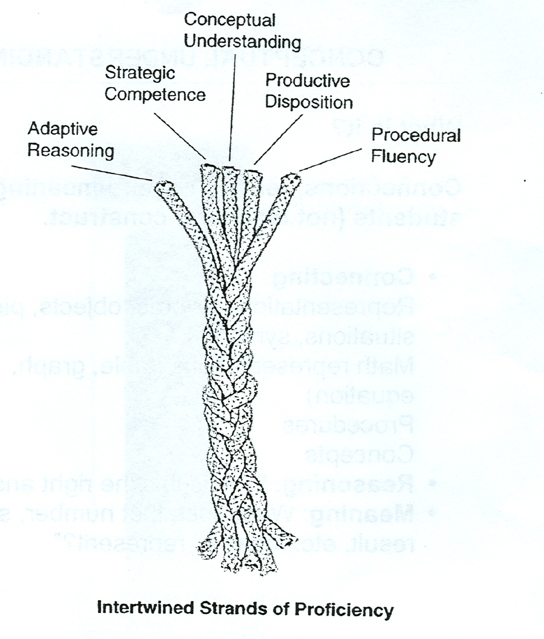
Mathematical Proficiency
Adding it up: helping children learn mathematics. Kilpatrick, Swafford, & Findell (Eds.), 2001. NRC.
Notes:
En Resumen: ayudar a los niños a aprender matemáticas. Kilpatrick, Swafford, y Findell (Eds.), 2001. NRC
the five strands of mathematical proficiency
conceptual understanding, procedural fluency, adaptive reasoning, strategic competence, and productive disposition
Most important distinction is between
conceptual understanding
procedural fluency

Slide 7
Mathematical Proficiency Strands
(1) conceptual understanding: comprehension of mathematical concepts, operations, and relations—knowing what mathematical symbols, diagrams, and procedures mean;
(2) procedural fluency: skill in carrying out procedures flexibly, accurately, efficiently, and appropriately;
(3) strategic competence: ability to formulate, represent, and solve mathematical problems using concepts and procedures appropriately;
(4) adaptive reasoning: capacity for logical thought, reflection, explanation, and justification or to extend from something known to something not yet known; and,
(5) productive disposition: habitual inclination to see mathematics as sensible, useful, and worthwhile, coupled with a belief in diligence and one’s own efficacy

Slide 8
1. Conceptual Understanding
Comprehending mathematical concepts, operations and relations—knowing what mathematical symbols, diagrams, and procedures mean.
Math is not isolated facts and procedures, but instead students are aware of many connections between mathematical ideas
Conceptual understanding “... is the ability to justify … why a particular mathematical statement is true or where a mathematical rule comes from” (CCSS-M, 2010
Notes:
1. Attention to the “Reciprocal”; 2. Commutative Property; 3. Attention to place value

Slide 9
MALLI Practices and Mathematical Language
Think about the language that you use language when you text? How does you language differ from when you send an email to a colleague? How does your language shift across contexts?
How do you define mathematical language?
Can you think of some examples of mathematical language?

Slide 10
Math Understanding &
Language “Register”
The mathematics language register includes discipline-specific words, expressions, and meanings (Halliday, 1978).
The language of the mathematics classroom has been described as a “register” of technical words, expressions, and meanings that differ from those of everyday language (Schleppegrell, 2007; Secada, 1992).
Terms have specialized meanings and also represent mathematical concepts such as “mean,” “expression,” “statement,” “function,” and “root,” to name a few.
MALLI Practices are trying to develop the mathematics register across languages
MALLI Practices
Biliteracy
Math Register

Slide 11
Understanding: Dividing Fractions
Does Multiplication always yield a larger product or solution?
Multiply: 4 by ½ and also 8 by ½
Now Divide 8 by ½?
What does it mean in division of fractions to flip the divisor and multiply or “invert and multiply?”
How can we use the “reciprocal” to understand the mathematics behind this process?
The Reciprocal is what we multiply a value by to get 1 also “multiplicative inverse”

Slide 12
2. Procedural Fluency
Carrying out procedures flexibly, accurately, efficiently, and appropriately; Involves fluency with procedures for arithmetic, precision, and using such procedures appropriately.
When students memorize procedures they fail to understand deeper ideas.
Understanding makes it easier to learn skills, while learning procedures can strengthen and develop math understanding.
Exp. 1: 62 – 48 = 26??

Slide 13
3. Strategic Competence
Ability to formulate, represent, and solve mathematical problems using concepts and procedures appropriately A concept or procedure is not useful unless students know where to use it.
Strategic competence refers to the ability to formulate mathematical problems, represent them, and solve them (NRC, 2001).
To solve a problem, the student’s first step is to “represent it mathematically in some fashion, whether numerically, symbolically, verbally, or graphically” (NRC, 2001, p. 124)
Notes:
2 to a seat 14, 5 remain (19 students total) – 5x3 and 2x2
Also Algebra 3x + 2y = 19
X+Y = 7
Solve for Y

Slide 14
3. Strategic Competence
Strategic Competence key features include problem solving and representations.
Exp1: If 12 students are on a mini bus and 7 more get on, how many Ss on the bus?
Exp2: A minibus has 7 seats that hold 2 or 3 students. If 19 students how many sit 2 to a seat? 3 to a seat?

Slide 15
4. Adaptive Reasoning
Capacity for logical thought, reflection, explanation, and justification or to extend from something known to something not yet known.
Reasoning is the “glue” that holds math together.
Thinking about the logical relationships between concepts and situations, students can see how elements of a problem fit together.
CCSS-M describe reasoning as “making conjectures and build a logical progression of statements to explore the truth of their conjectures” and also emphasize students’ ability to “justify their conclusions, communicate them to others, and respond to the arguments of others”
Ball and Bass (2003) have argued that reasoning is as fundamental to knowing and using mathematics as comprehension of text is to reading.

Slide 16
Adaptive Reasoning
Best way to improve reasoning is to explain or justify a solution to others.
Exp1: Instead of asking for the corrects answer, we ask, “Why do you think the answer is correct?”

Slide 17
5. Productive Dispositions
Seeing mathematics as sensible, useful, and doable—if you work at it—and being willing to do the work.
Engaging students in mathematical activity is the key to success.
Math proficiency goes beyond being able to understand, compute, apply, and reason.
Students engaged with math see themselves as effective learners, doers, and users of math.
Engaging requires frequent opportunities to make sense of math, and recognize benefits of perseverance. Also builds confidence.
Growth Mindset (Fixed vs. Growth)
Exp: Develop story problems using known contexts.
Exp: Organize for small victories—to experience success

Slide 18
Mathematical Proficiency Strands
(1) conceptual understanding: comprehension of mathematical concepts, operations, and relations;
(2) procedural fluency: skill in carrying out procedures flexibly, accurately, efficiently, and appropriately;
(3) strategic competence: ability to formulate, represent, and solve mathematical problems;
(4) adaptive reasoning: capacity for logical thought, reflection, explanation, and justification; and,
(5) productive disposition: habitual inclination to see mathematics as sensible, useful, and worthwhile, coupled with a belief in diligence and one’s own efficacy

Slide 19
Using Stories to
Support Math Learning

Slide 20
Example 1. (Kindergarten)
Context:
The teacher began the math lesson with a story about a woman
who owned many cats and lived behind the school.
Turner, Celedon-Patichis, Marshall, & Tennison, 2008
Notes:
Math proficiency: Strategic competence (Problem Solving) & Procedural Fluency (carrying out arithmetic)
Literacy- Storytelling?

Slide 21
Example 1
1.
2.
3.
4.
Notes:
Math proficiency: Strategic competence (Problem Solving) & Procedural Fluency (carrying out arithmetic)
Literacy- Storytelling?

Slide 22
Example 1
5.
Strategic Competence (Problem Solving)
Procedural Fluency
6.
7.
Discourse
(Revoicing)
Notes:
Math proficiency: Strategic competence (Problem Solving) & Procedural Fluency (carrying out arithmetic)
Literacy- Storytelling?

Slide 23
Example 2. (1st Gr.)
Context
Teacher poses a problem: “Alan has 16 chocolates and Oscar has 6. How many more chocolates does Alan have?"
A student used cubes to represent the solution to the problem.
(Musanti, Celedon-Pattichis & Marshall, 2009)
Notes:
Stratetic Competence (Representation using cubes) & Procedural Fluency (carrying out arithmetic 16-6=10) & ADAPTIVE REASONING (Explained how counted) & Dipositions (Engagement—chocolates??)
Literacy - storytelling

Slide 24
Example 2
1.
2.
3.
4.
5.
6.
7.
8.
9.
(Musanti, Celedon-Pattichis & Marshall, 2009)
Notes:
Stratetic Competence (Representation using cubes) & Procedural Fluency (carrying out arithmetic 16-6=10) & ADAPTIVE REASONING (Explained how counted) & Dipositions (Engagement—chocolates??)
Literacy - storytelling

Slide 25
Example 3. (K) Pt. 1
Context
Ms. Sandra had six candies. Ms. Mary ate four. How many are left?
After posing the problem, Ms. Elba had one student model how she solved it using her fingers and then she asked several students to go the front of the room to draw how they did the problem.
(Musanti, & Celedon-Pattichis, 2013)
Notes:
Understanding & Strategic Competence (Prob solving) & Representations (cicles) & Dispositions (Engaged in story about teachers eating candies)

Slide 26
1.
2.
3.
4.
5.
(Musanti, & Celedon-Pattichis, 2013)
Notes:
Understanding & Strategic Competence (Prob solving) & Representations (cicles) & Dispositions (Engaged in story about teachers eating candies)

Slide 27
Ms. Elba then posed the following word problem,
“In my fish tank I put five fish and then Ms. Craw gave me three more. How many do I have in the fish tank?
Students began to put up one hand to illustrate five fish and three fingers to represent the set of three fish.
After a student shared and modeled his solution to the problem on the board using a drawing and adding a number sentence (5 + 3 = 8), Ms. Elba decided to challenge students and asked them to read aloud the number sentence in English for the first time.
(Musanti, & Celedon-Pattichis, 2013)
Notes:
Strategic competence: PROBLEMSOLVING & Mulitple representations FINGERS & Drawing & number sentence

Slide 28
Students were asked to read the number sentence in English 5+3=8
6.
7.
8.
9.
10.
11.
12.
13.
14.
(Musanti, & Celedon-Pattichis, 2013)
Notes:
Discourse Teacher moves
Vocabulary Same and like → Equal: Strategy: Cognates;
Academic language Register: same or equal – you can use either but we are going to try and use a new word

Slide 29
S’s: “Five plus three same as eight” while others read it as “Five plus three same like eight”
15.
16.
17.
18.
19.
20.
(Musanti, & Celedon-Pattichis, 2013)
Notes:
Discourse Teacher moves
Vocabulary Same and like → Equal: Strategy: Cognates;
Academic language Register: same or equal – you can use either but we are going to try and use a new word

Slide 30
ExAMPLE. 4 (K)
Ms. Arenas posed several problems related to the upcoming Easter holiday, including the following multistep problem:
“Ms. Arenas had two boxes of chocolate eggs, and each box had four eggs. Then I ate two chocolate eggs. How many do I have left?”

Slide 31
Notes:
Eliciting more information: lines 3, 9, and 11; Action-Representation 7 & 11; Models Math Language 11

Slide 32
Ex. 4: Dalia Solves a multistep problem
In this episode, Ms. Arenas used a series of probes (lines 3, 9, and 11) to elicit details of Dalia’s strategy and to communicate the discursive norm that one needs to explain one’s thinking.
Additionally, she provided a frame for Dalia’s explanation that was based on describing the actions in the story (Y luego me comi’ dos, line 7) and explaining how she represented those actions in her drawing (Como sabes cuales son los que comi’?, line 11). We also see how Dalia
Responded in ways that reinforced important discursive norms—by using more mathematical language (i.e., stating that six were left) and referring to visual representations (i.e., indicating that she crossed out circles in her drawing) to communicate her reasoning.

Slide 33
Math Proficiency & MALLI Practices
Math Proficiency
Understanding Procedural Fluency Strategic Competence Reasoning Prod. Dispositions
Mathematic Representations
(Strategic Competence)
Across Languages in Dual Language Contexts
Literacy
Familiar Story Problems
(Strategic Competence,
Productive Dispositions
Procedural Fluency)
Vocabulary
Math Language (Register)
(Understanding)
Discourse
Techer moves asking for explanations
(Reasoning)

